Slide 1
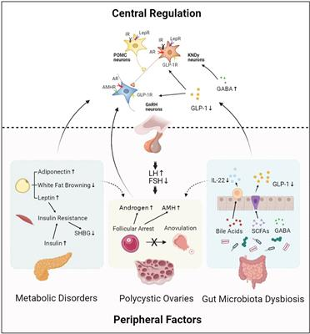
Polycystic Ovary Syndrome Detection using Deep Learning
By : L.AMULYA
Student of Gitam University
Department of CSE , Data Science
2023005720

Slide 2
Abstract :
Polycystic Ovary Syndrome (PCOS) is a prevalent endocrine disorder affecting women in their reproductive years, characterized by elevated androgen levels, oligomenorrhea, anovulation, and the presence of ovarian cysts or ingrown follicles. This disorder impedes follicular growth, hindering ovulation. Anovulation in women with PCOS may result in weight gain, facial and neck hair growth, irregular menstrual cycles, and an elevated risk of developing high blood pressure and diabetes over time. Early diagnosis of PCOS is crucial to mitigate the risks of infertility, diabetes, and heart disease. In this project, we propose a methodology for early PCOS diagnosis.
Our approach involves training a deep learning model using a dataset comprising 541 patients sourced from Kaggle. The performance of the deep learning classifier is compared with traditional classifiers such as Decision Trees (DT), Support Vector Machines (SVM), and Random Forests (RF). The deep learning model achieves an impressive accuracy of 98.07%, surpassing the accuracy of other classifiers (ranging from 83-96%). This suggests that the proposed deep learning model is highly effective in PCOS prediction. The study underscores the superiority of our deep learning model in accuracy compared to various classifiers utilized by different authors for PCOS prediction. The inclusion of omics data holds the potential to further enhance the accuracy of our proposed system.

Slide 3
Introduction :
Polycystic Ovary Syndrome (PCOS), a prevalent endocrine disorder impacting women's health globally, is associated with infertility and potential health complications like hypertension and diabetes if left untreated . While the hormonal disorder's exact cause remains elusive, an increase in androgens and insulin resistance is observed. Insulin resistance manifests through skin darkening in specific areas. The disruption of the hypothalamus-hypophysis-ovary axis, influenced by insulin resistance, results in heightened androgen levels, primarily responsible for PCOS . Women with PCOS exhibit symptoms such as excessive hair growth, irregular menstrual cycles, oily skin, and weight gain. In India, approximately 23% of women grapple with PCOS. Artificial Intelligence (AI) has made significant strides in various fields, including healthcare, where machine learning and deep learning models are being employed to detect PCOS.
This project proposes a Deep Learning model for PCOS prediction, comparing its performance with other classifiers like SVM, DT, and RF, using a dataset of 541 patients from Kaggle. The paper's structure includes an introduction , a review of related work , materials and methods , the proposed model , result analysis, and conclusions with future prospects . The integration of Explainable AI (XAI) is explored for enhanced transparency and trust in disease prediction systems

Slide 4
How can deep learning help in detection of pcos
Deep learning can play a significant role in the detection of Polycystic Ovary Syndrome (PCOS) through various mechanisms:
Pattern Recognition:
Deep learning models excel at recognizing complex patterns in large datasets.
By training on diverse data, these models can learn subtle patterns and associations indicative of PCOS, contributing to accurate detection.
Feature Extraction:
Deep learning algorithms can automatically extract relevant features from various types of data, such as hormonal levels, ultrasound images, or patient history.
This ability to extract features helps in identifying key indicators of PCOS, improving diagnostic accuracy.
Multimodal Data Integration:
PCOS diagnosis often involves analyzing data from multiple sources, such as hormone levels, medical history, and imaging.
Deep learning models can integrate and analyze these diverse data types, providing a more comprehensive understanding for accurate detection.
Handling Non-linearity:
PCOS is a complex, multifaceted condition with non-linear relationships between symptoms and potential risk factors.
Deep learning models can capture and model these non-linear relationships, offering improved diagnostic capabilities compared to traditional linear models.
Adaptability to Diverse Data:
Deep learning models can handle a wide variety of data formats, including structured data (e.g., lab results), unstructured data (e.g., images from ultrasound scans), and textual data (e.g., patient records).
This adaptability makes them versatile for integrating and processing different types of information relevant to PCOS.
Automation and Efficiency:
Deep learning models can automate the analysis of large datasets, making the diagnostic process more efficient.
Automated detection systems can assist healthcare professionals in quickly identifying potential cases of PCOS, facilitating early intervention.
Improving Personalized Medicine:
Deep learning models, when trained on diverse datasets, can contribute to personalized medicine by considering individual variations in symptoms and risk factors.
This can lead to more tailored and effective treatment plans for individuals with PCOS.
Continuous Learning:
Deep learning models can be designed to continually learn and adapt based on new data, improving their diagnostic capabilities over time.
This adaptability is crucial for staying updated with evolving medical knowledge and understanding of PCOS.
In summary, deep learning contributes to PCOS detection by leveraging its pattern recognition abilities, feature extraction capabilities, and adaptability to diverse data types.
This technology has the potential to enhance the accuracy, efficiency, and personalized nature of PCOS diagnosis, ultimately improving patient outcomes.

Slide 5
Literature Survey :
Researchers and academics have contributed numerous artificial intelligence (AI) and deep learning algorithms for predicting Polycystic Ovary Syndrome (PCOS) based on clinical features and common symptoms. In a comprehensive review explored the relationship between various clinical features and PCOS, utilizing data from Kaggle. The dataset included information from 541 patients with 44 features, analyzed using the Pearson correlation method and various classifiers. The Multilayer Perceptron and Support Vector Machine (SVM) achieved an accuracy of 93%. Another study , employing the CatBoost classifier and K-fold validation, achieved 82.5% and 90.1% accuracy for invasive and non-invasive procedures, respectively. Authors in used the CatBoost model with hard and soft voting classifiers, achieving an accuracy of 91.12% by selecting the top 13 features from a total of 41 through cross-validation. A machine learning-based system for PCOS diagnosis in employed various classifiers, yielding an accuracy of 93.25%. Meanwhile, utilized an ensemble random forest classifier with feature selection, obtaining 100% accuracy and 98.89% sensitivity. In, a model combining Random Forest, Linear Regression, Gradient Boosting, and Hybrid Random Forest-Logistic Regression achieved an overall accuracy of 91%. Authors in discovered a model using the Boruta Shap technique and a random forest classifier to identify significant clinical features, obtaining an accuracy of 86% with a dataset of 72 PCOS and 72 non-PCOS women.

Slide 6
Methodology :
A. Dataset Description
The dataset used in our research is obtained from open-source platform Kaggle which consist of data of 541 women. The data was sample data from 10 hospitals of Kerala and consists of 43 different attributes . The independent variable called the target attribute in the dataset is 'PCOS (Yes/No)‘. 1 77 women in 541 records of the dataset were diagnosed with PCOS. The categorical data of the attribute ‘PCOS (Yes/No), Y and N was converted into land 0 respectively. 24 attributes out of 43 did not include any medical instruments for diagnosis while other features were detected using vaginal ultrasound and various blood samples.
B. Data Pre-Processing
The dataset obtained from Kaggle is pre-processed and cleaned and therefore we only had to perform few steps to make the dataset look cleaner and more accurate. We used python libraries such as NumPy, Matplotlib, seaborn for preprocessing and cleaning the data. The Matplotlib was used to find the outliers in our dataset. When dataset was analysed, we found no outliers and hence entire dataset of 541 records was used for the prediction in the ML model. We can find the outliers with the help of Matplotlib. NumPy library of python was used to find all the missing values and then the median was chosen to remove all the null values. The attributes such as file no and serial no do not have any implication on the target variable and hence such data is removed from the dataset. Removing unwanted data from the dataset helps in analysing and training the model easy.

Slide 7
Moreover, we created two data frames and one of them is divided into train-test in the ratio of 70:30 and other data frame is divided in the ratio of 80:20. The two data frame will help in analysing the performance better. Feature Scaling was done after splitting of data. Standard scalar algorithm is used for the feature scaling. In the target attribute -PCOS (Yes/No)‘ There was an imbalance since only 177 women had POS and therefore, we used SMOTE (Borderline Minority Oversampling Technique) for balancing the data. The data balancing is important so that it will reduce the risk of improper training of the model. After data balancing 364 and 364 data records are available for PCOS and Non-PCOS.
C. Feature Selection
In this section we will discuss about the three algorithms that will help in feature selection. The Harris Hawk and the Salp Swarm Optimization are the two wrapper class algorithms that are used for the feature selection. The results obtained from the two algorithms are compared with the help of Mutual Information algorithm and thereby features are selected for the prediction. Feature selection has an important role in model training since it helps in removing unwanted data from the dataset. The reduced dataset obtained after feature selection will be less bulky and hence easy to manage and train the model.

Slide 8
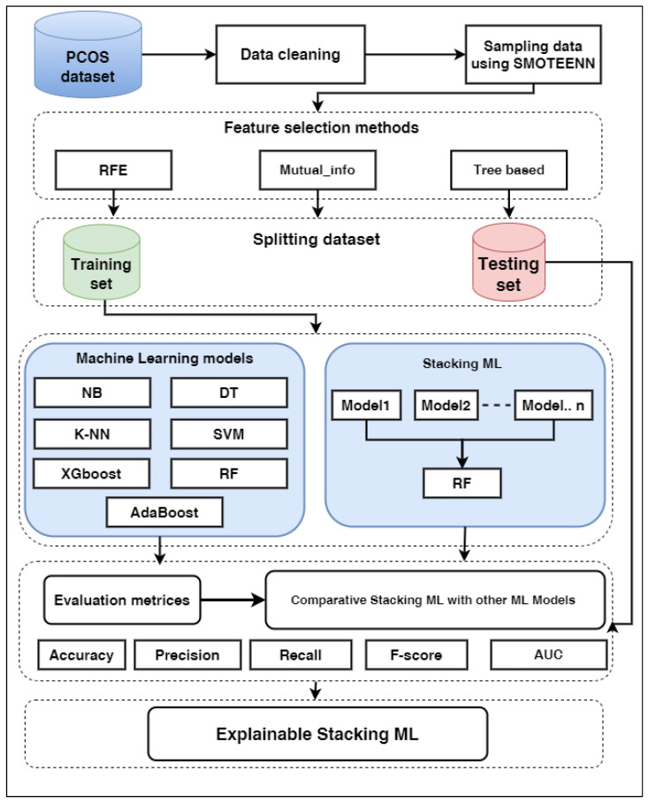

Slide 9
Harris Hawks Optimization (HHO): The algorithm uses the random features for the selection of the attributes. The algorithm basically includes two phases. The first phase is the exploration and the other phase is exploitation. After applying the algorithm 15 features were selected out of which 8 features were non-invasive.
Salp warm Optimization (SSA): The algorithm is a wrapper method in which behaviour of salp such as navigation, swarming and ocean foraging are studied to find the optimum solution. SSA gives a more accurate solution to the random solutions obtained through Harris Hawk. The entire dataset is divided into categories where one will be considering a leader and the other is called the follower. SSA also has two phases of exploration and exploitation. The function of the leader's position and the location of the target gives the position of the followers. Intelligence makes the SSA well known and it also it gives good sensitivity, performance and robustness compared to other models. The algorithm obtained 19 features in which 13 features were non-surgical.
Mutual Information (MI): The MI algorithm is used to find out the important data and considers the features which have numeric value in the dataset. The algorithm is completely based on the entropy as it helps in measuring the uncertainty. Mutual Information quantifies the common data between two features and is denoted by M I (F; S) and is described by the Equation (1).
MI(F;S)=∑s∈S∑f∈Fp(f, s)logp(f, s)(f)p(s)

Slide 10
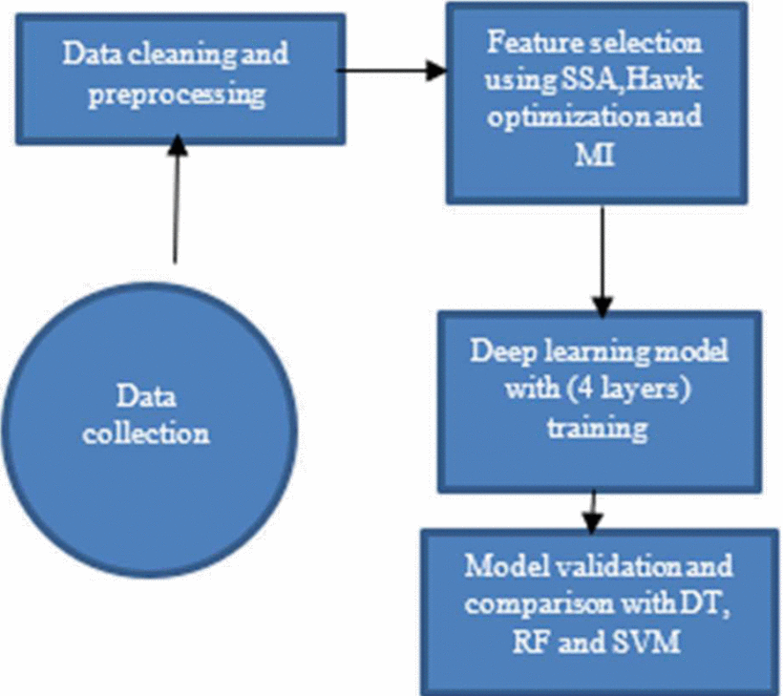
If MI value obtained using the Equation (1) is higher than the two features are very closely related with each other but if the value obtained using the equation (1) is 0 then the two features are independent of each other. When MI is applied to the dataset then it will give an idea of how all the features are related to the target variable. The features whose MI values turn to 0 are removed from the dataset. Hence, after applying the filter method 15 features are selected and are ranked according to their relation with the target variable. Figure 1. shows the selected 15 features according to the rank of their correlation with the target variable 'PCOS (Yes/No)‘.

Slide 11
Proposed Work
In our proposed work we have used DL approach for the prediction of PCOS. Deep Learning is one of the kinds of Machine Learning and is very different from the various common algorithms and methods. It uses different models for the processing and representation of the data that contain different layers of the ANN (Artificial Neural Network) . A DL is basically a perceptron multilayer model. It also has the properties of ANN and is basically trained with gradient descent curve using back propagation algorithm. ANN is made of four layers consisting of nodes and neurons and are only directed in a single direction. The node in the ANN is connected to the next node with two hidden layers in a single direction. Moreover, ANN uses multiple threads for model processing. The stochastic gradient descent is used by the learning model. The proposed model uses the 4 layers. One input layer is used for the entry of the data, output layer for the result prediction and the hidden layers for execution of the data in an iterative manner. Optimization of the model is the toughest challenge in machine learning which means optimizing the code so that testing error should be minimized. In deep learning model is optimized by tuning its outliers. Adaptive learning rate, mean bias, momentum training and dropout are used for minimizing the testing error . Learning rate is one of the most important hyperparameter that measures the speed of the progress in the learning model. The next hyperparameter is the number of hidden units. Ll and L2 regularization are used to prevent overfitting. L 1 and L2 are called as Lasso Regression and Ridge Regression respectively .

Slide 12
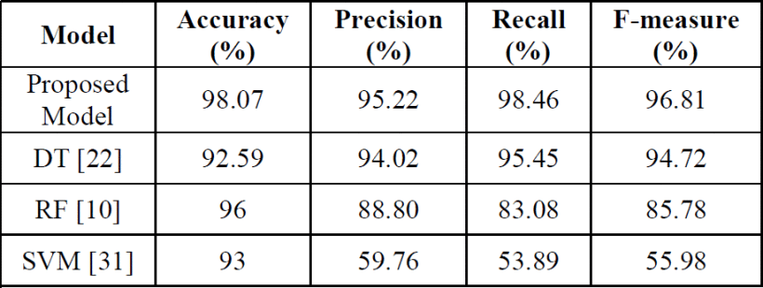
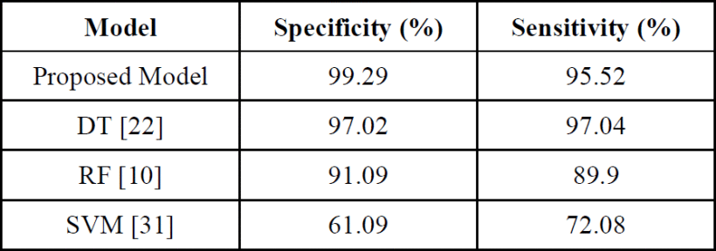
Result and Discussion
We have proposed a DL method for the prediction of PCOS on the dataset obtained from Kaggle. When our proposed model is compared with the other classifiers that have been already used by the researchers our model came out with the maximum accuracy of 98.07 % which can be seen in the table. Since accuracy alone is not enough to decide whether a model is good enough therefore, we used additional performance matrices such as specificity, sensitivity, precision- score, class-recall.

Slide 13
Conclusion and Future Work
PCOS if remain untreated it can lead to the most threatening life diseases such as blood pressure, diabetes. Hence, it is necessary for an early diagnosis. The model proposed by us provided the best accuracy in the prediction of PCOS till date. A robust system can be developed in the coming years in the form of an or a website where our proposed DL algorithm can be used in the early prediction of PCOS

Slide 14


